Slide 1
snATAC-seq Data Processing/Pipeline
Asa Thibodeau, PhD
November 21st 2022

Slide 2
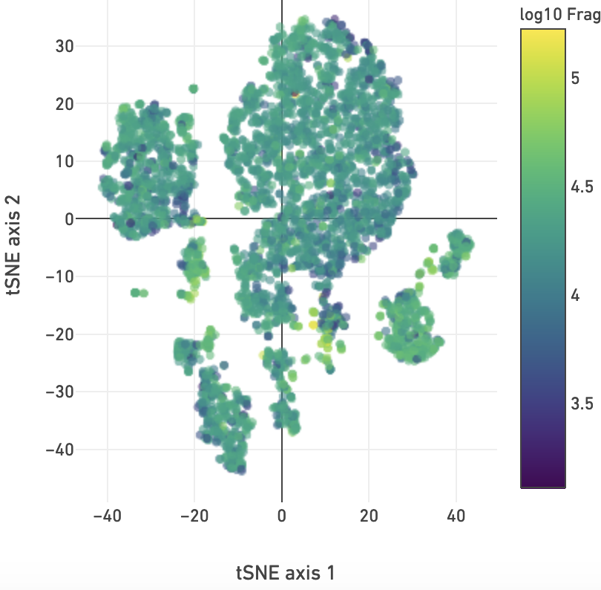
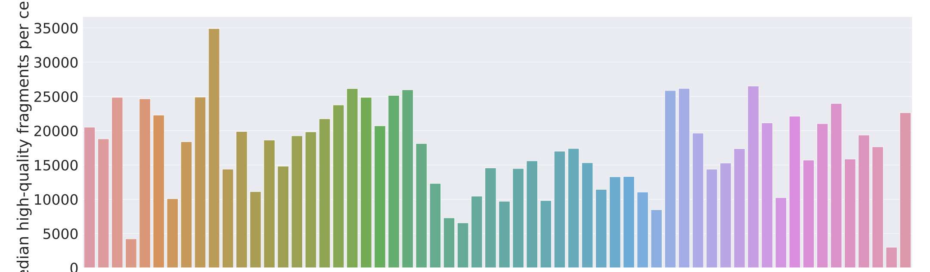
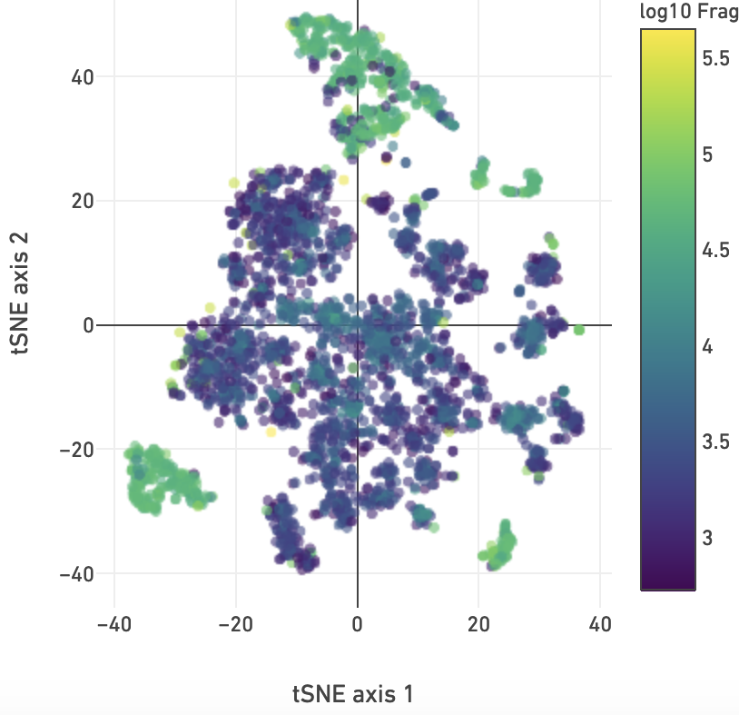
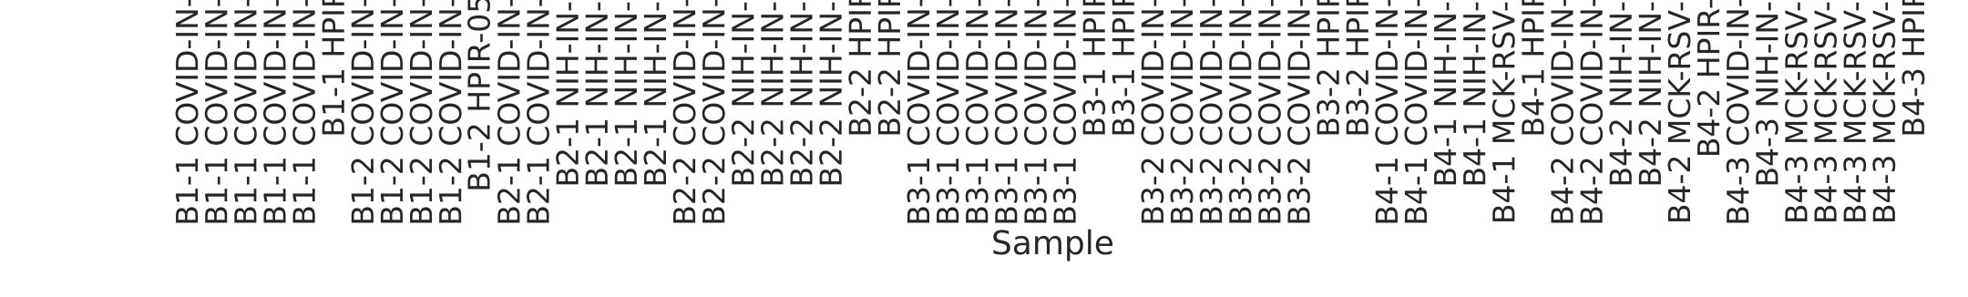
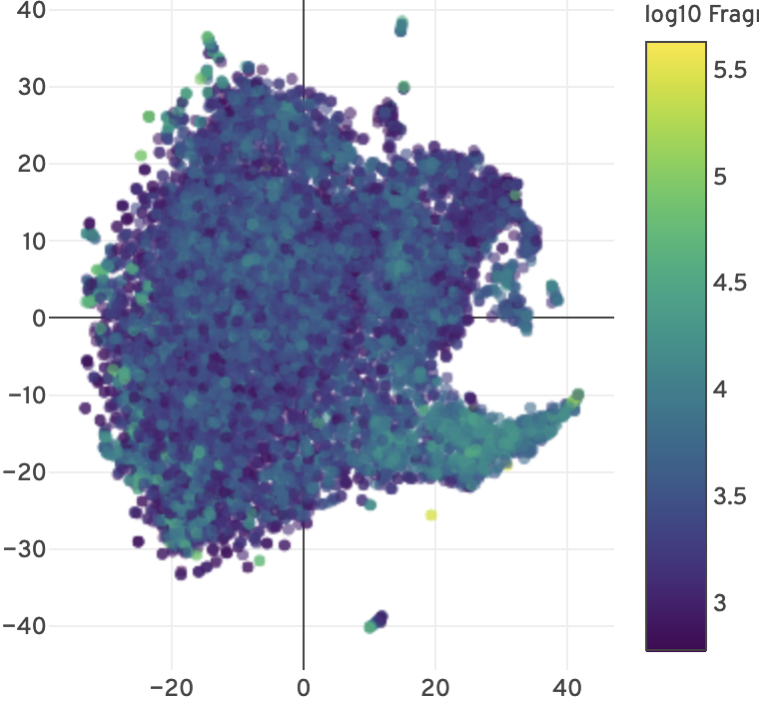
Step 1: Sample QC
Example 1
Example 2
Example 3
Example2
Example1
Example3

Slide 3
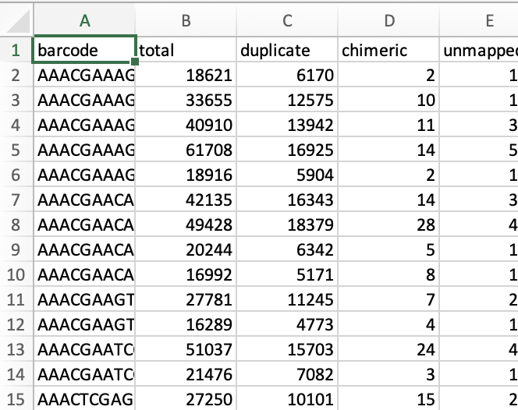
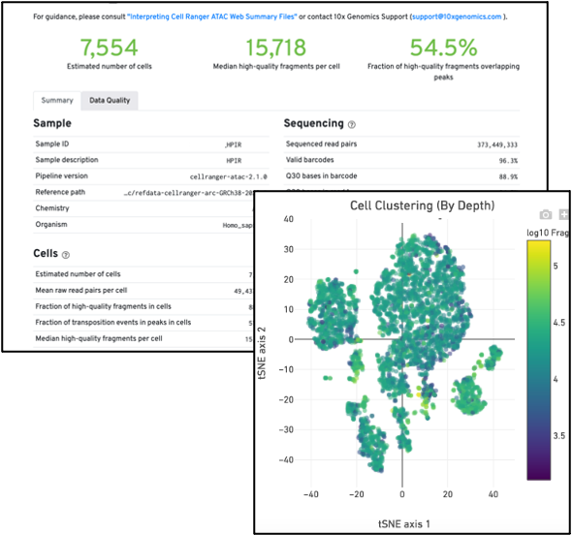
Step 1: Sample QC
Web Summary (web_summary.html)
Summary
(summary.csv)
Single Cell
(singlecell.csv)
Sample ID
Genome
Pipeline Version
Estimated Number of Cells
Median high quality fragments
TSS Enrichment Scores
Etc.

Slide 4
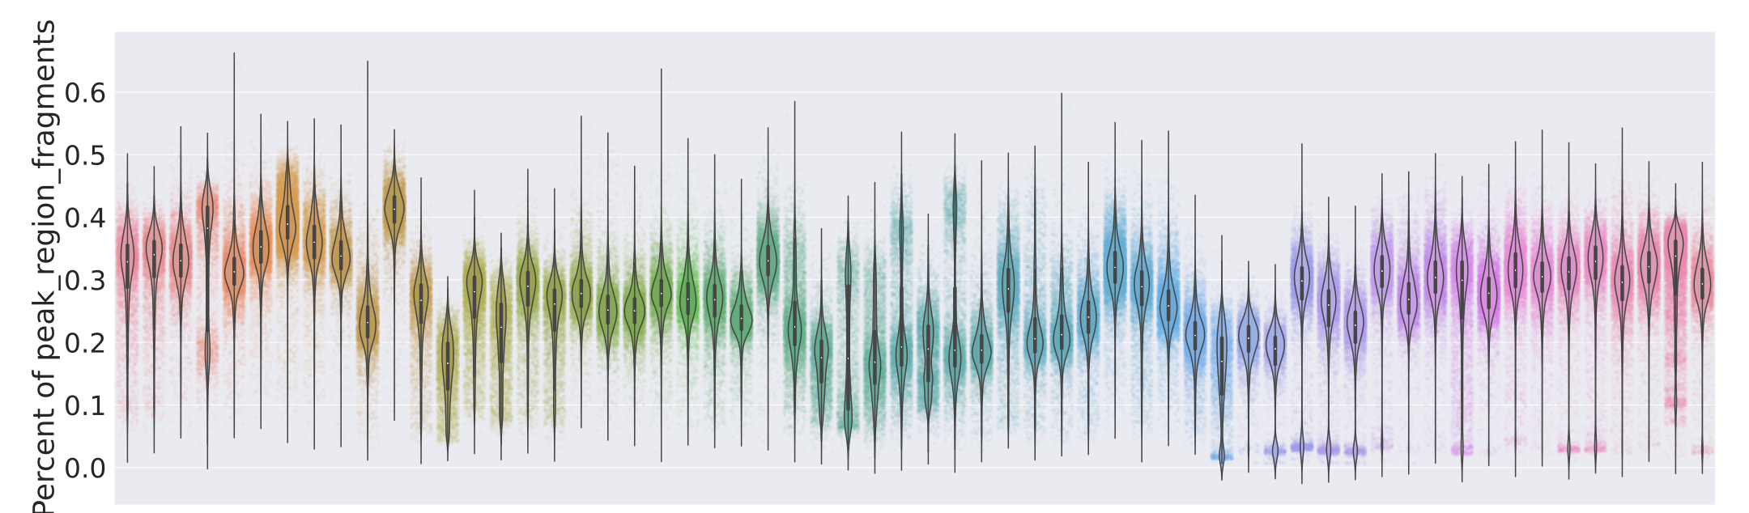
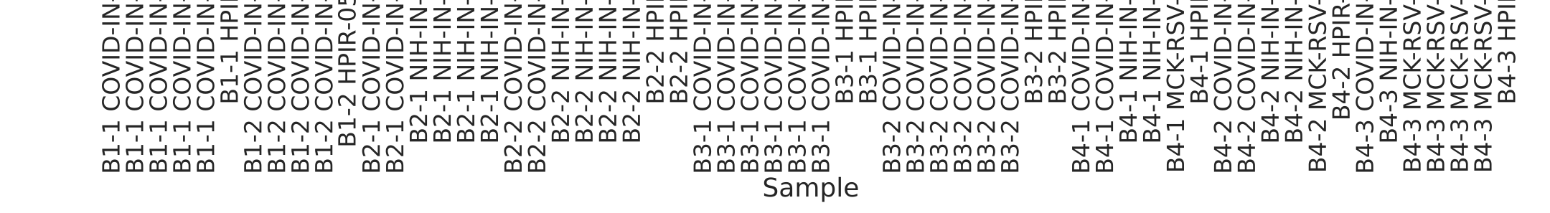
Step 1: Sample QC

Slide 5
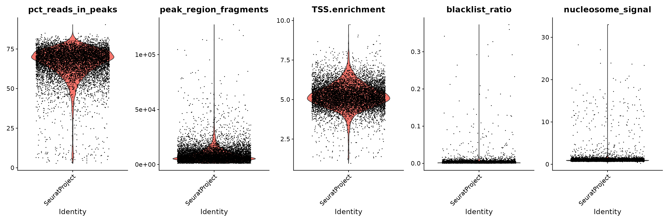
Step 2: Cell QC
https://stuartlab.org/signac/articles/pbmc_vignette.html
pbmc <- AddMetaData(pbmc, pbmc$peak_region_fragments/pbmc$total, col.name="pct_peaks")
pbmc <- AddMetaData(pbmc, pbmc$TSS_fragments/pbmc$total, col.name="pct_tss")
pbmc_subset <- subset(
x = pbmc,
subset = restrictionlist_fraction < 0.05 &
nucleosome_signal < 4 &
pct_peaks > 0.15 &
peak_region_fragments > 3000 &
pct_tss > 0.10
)

Slide 6
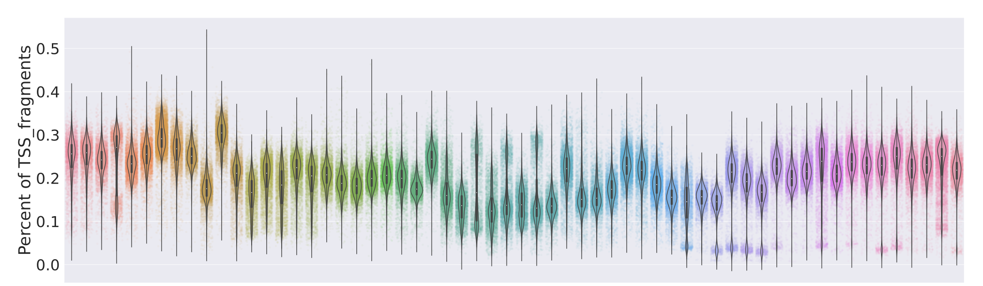
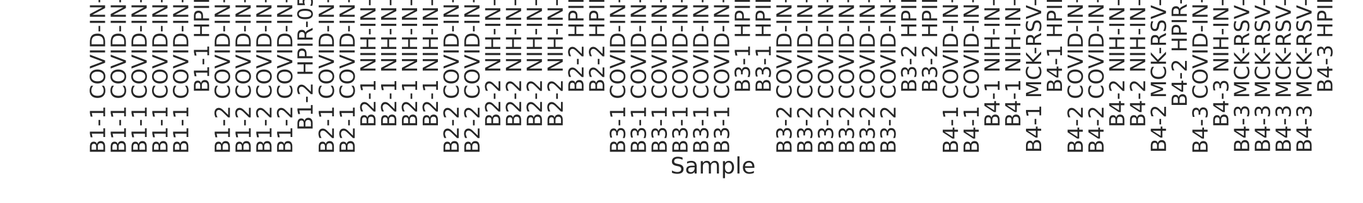
Step 2: Cell QC

Slide 7
Step 2: Cell QC
Once the good quality cells are identified, create a new single cell CSV file with only those barcodes!

Slide 8
Step 3: AMULET
AMULET
Filtered Single Cell CSV
Multiplet
Barcodes
Fragments File

Slide 9
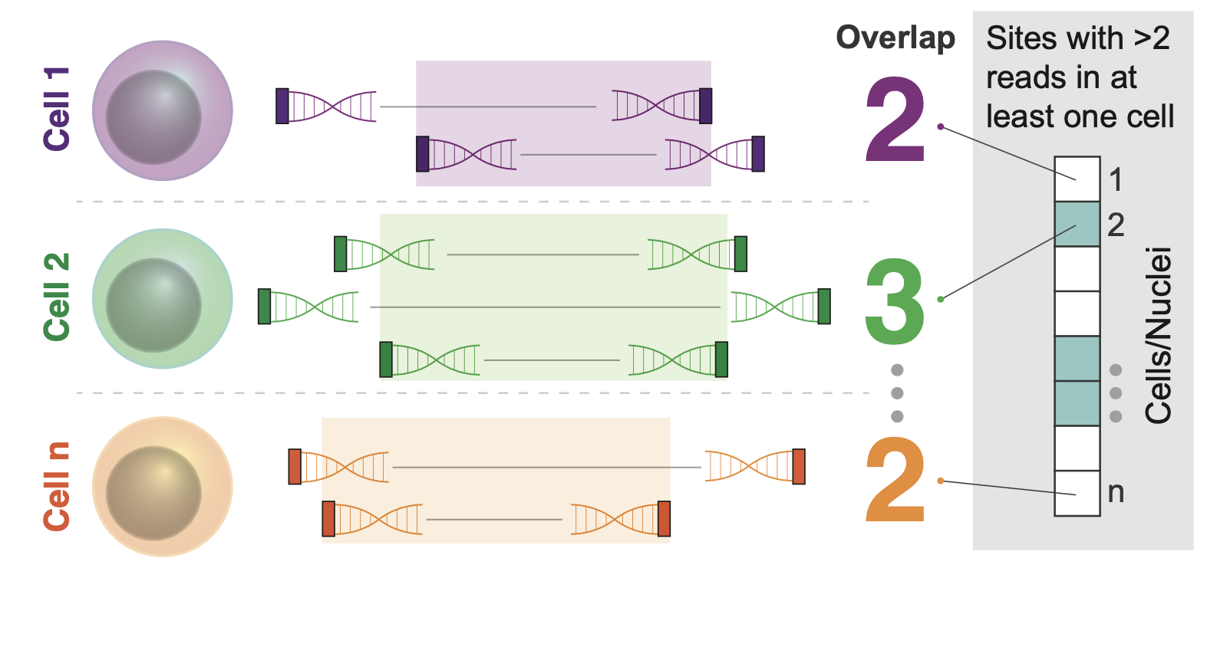
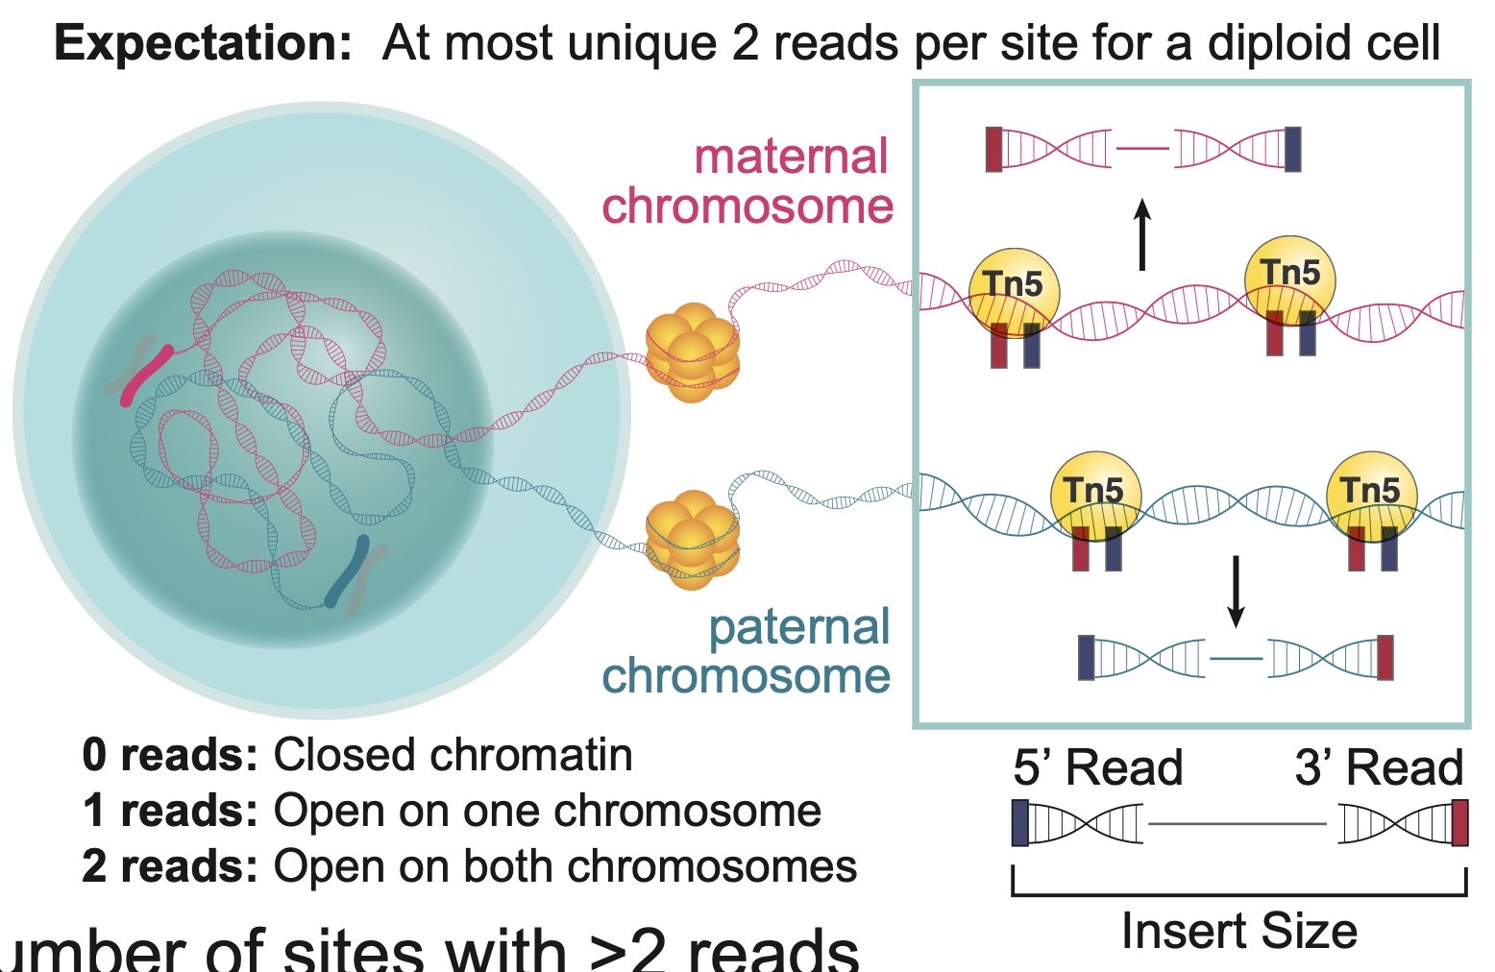
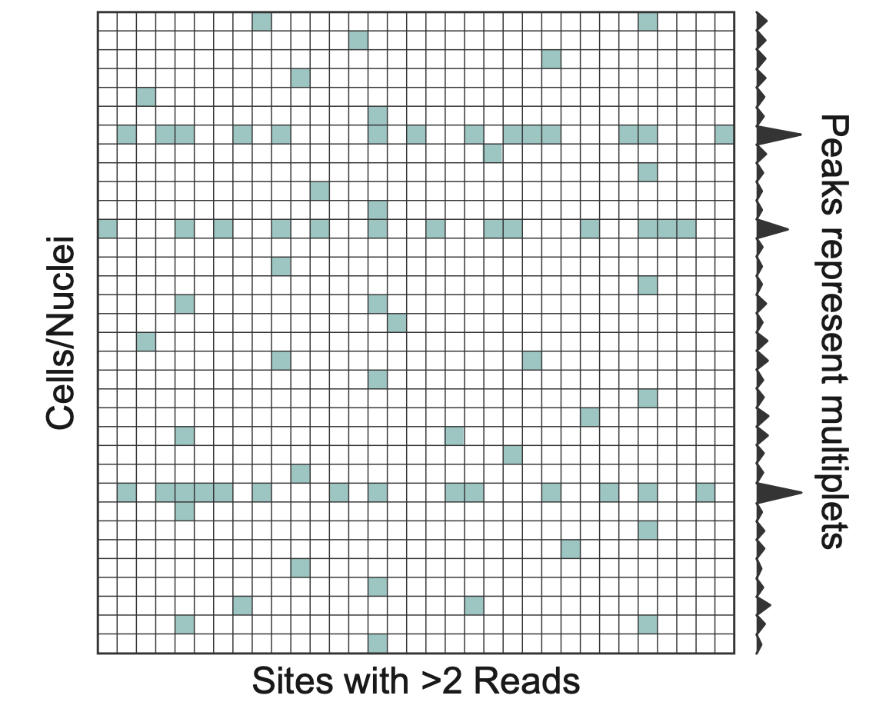
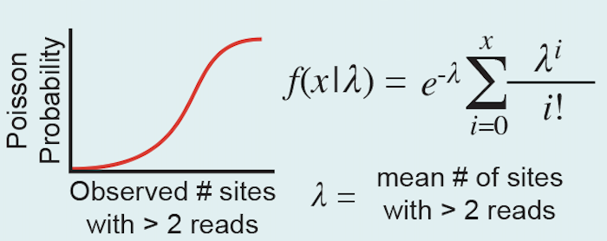
Step 3: AMULET
Step 1: Identify overlaps > 2 within each nucleus
AMULET - ATAC-Seq Multiplet Estimation Tool
Step 2: Identify cells enriched with overlaps >2
AMULET: a novel read count-based method for effective multiplet detection from single nucleus ATAC-seq data
Thibodeau, Eroglu et al. Genome Biology. (2021)

Slide 10
Step 3: AMULET
Remove multiplets using AMULET (FDR < 0.05).
Example:
/AMULET-v1.1/AMULET.sh ${fragmentfile} ${filteredcsv} /AMULET-v1.1/human_autosomes.txt /RestrictionRepeatLists/restrictionlist_repeats_segdups_rmsk_hg38.bed ${outputdirectory} /AMULET-v1.1/
python3 /AMULET-v1.1/AMULET.py --q 0.05 --rfilter /RestrictionRepeatLists/restrictionlist_repeats_segdups_rmsk_hg38.bed ${outputdirectory}/Overlaps.txt ${outputdirectory}/OverlapSummary.txt ${outputdirectory}

Slide 11
Step 3: AMULET
Make a new single cell CSV file without the multiplets!
Keep track of multiplets if you are interested in proliferating cells (These will be detected as multiplets by AMULET)
Should have 3 singlecell.csv files (per sample) at this point (Use these to trace back which cells were kept/remove, how many, and why!)
Original
Cell QC
AMULET
Singlecell.csv
Singlecell_
CellQC.csv
Singlecell_
AMULET.csv

Slide 12
Step 4: Merging/Combining Peaks
Each sample is represented as a matrix of of Cell Barcodes and Peaks
Cell Barcodes
Peaks
Not every peak is present is every sample!

Slide 13
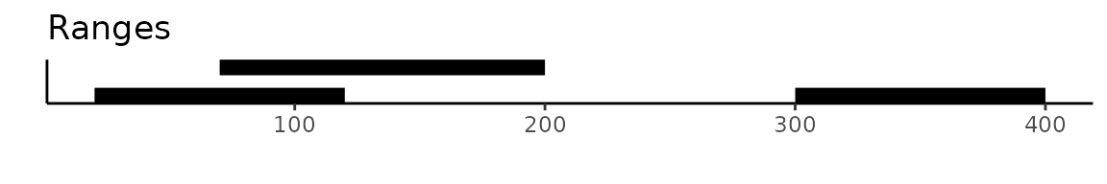
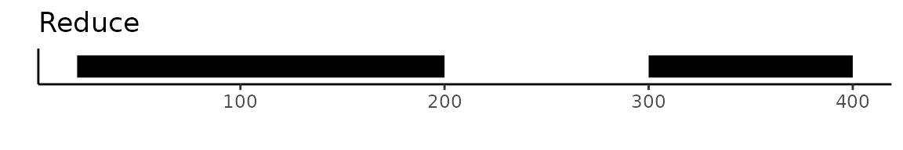

Step 4: Merging/Combining Peaks
https://stuartlab.org/signac/articles/merging.html

Slide 14
Step 4: Merging/Combining Peaks
S1
T
S2
T
S2
H
?
Combined Peaks

Slide 15
Step 4: Merging/Combining Peaks
Sample Peaks
Cell Barcodes for multiple samples
Peaks
(present in at least n samples)
Combined
Peaks

Slide 16
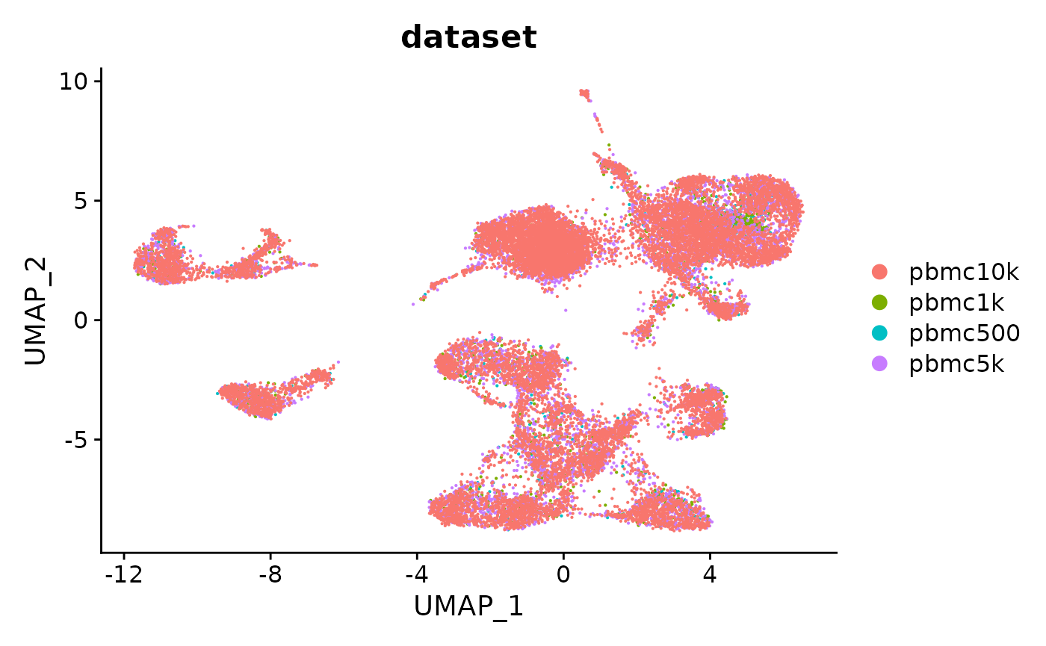
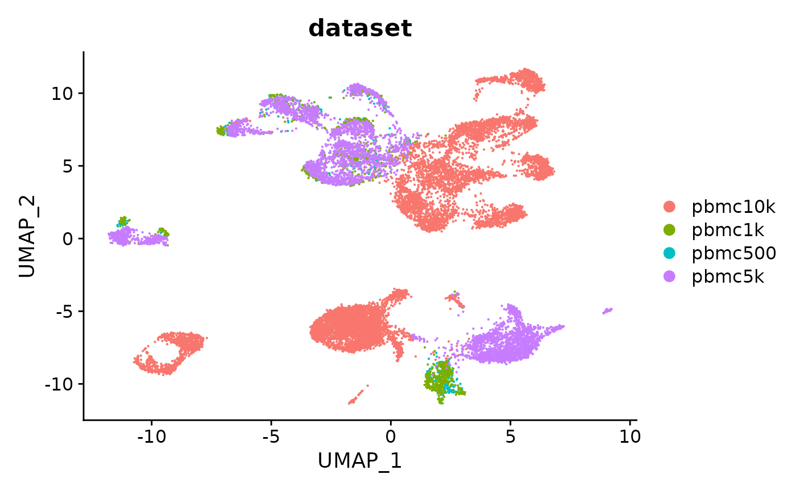
Step 4: Merging/Combining Peaks
Unified Peak Set
Using All Peaks From All Samples

Slide 17
Step 5: Clustering & batch correction
Perform initial clustering using Term Frequency – Inverse Document Frequency (TF-IDF) and Singular Value Decomposition (SVD)
Example code:
merged_atac <- RunTFIDF(merged_atac)
merged_atac <- FindTopFeatures(merged_atac, min.cutoff = 300) # 10*num samples
merged_atac <- RunSVD(merged_atac)
DepthCor(merged_atac, n=50)
Use DepthCor to see the read depth with respect to the number of comp.

Slide 18
Step 5: Clustering & batch correction

Slide 19
Step 5: Clustering & batch correction

Slide 20
Step 5: Clustering & batch correction

Slide 21
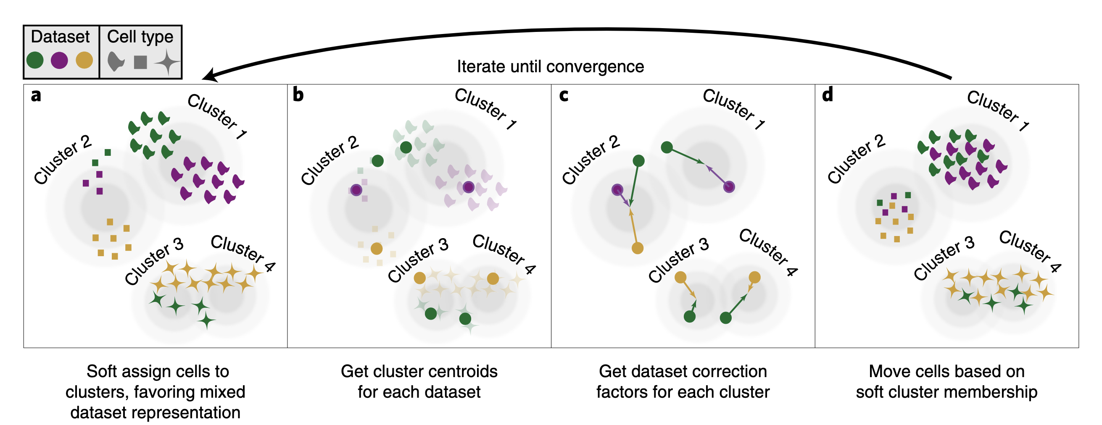
Step 5: Clustering & batch correction
Korsunsky et al (2019)

Slide 22
Step 5: Clustering & batch correction
Correct for batch effects by providing the batch meta data and applying harmony using the batch information.
Example code:
library(harmony)
merged_atac.harmonized <- RunHarmony(
object = merged_atac,
group.by.vars = c("batch"),
reduction = 'lsi',
assay.use = "ATAC",
project.dim = FALSE
)

Slide 23
Step 5: Clustering & batch correction
Clusters after applying Harmony

Slide 24
Step 5: Clustering & batch correction
Batches after applying Harmony

Slide 25
Step 6: Gene annotation
Extract the coordinates of gene promoters and add them as annotations
# extract gene annotations from EnsDb
annotations <- GetGRangesFromEnsDb(ensdb = EnsDb.Hsapiens.v75)
# change to UCSC style since the data was mapped to hg19
seqlevelsStyle(annotations) <- 'UCSC'
# add the gene information to the object
Annotation(pbmc) <- annotations
https://stuartlab.org/signac/articles/pbmc_vignette.html
Database R packages with promoter coordinates:
HG19 - EnsDb.Hsapiens.v75
HG39 - EnsDb.Hsapiens.v86

Slide 26
Custom Gene annotation
Signac utilizes the Genomic Ranges package to define the regions to pull ATAC-seq reads and describe accessibility within gene promotes and gene bodies
A Genomic Ranges object must have the following meta data columns to function in Signac:
gene_name (i.e., the gene symbol)
gene_id (i.e., the ensemble id)
gene_biotype (Signac filters transcripts, and selects for “protein_coding”)
Using extend.upstream and extend.downstream in GeneActivity function, Signac will extend the gene body in the following manner:
extend.upstream
extend.downstream
extend.downstream
extend.upstream

